Slide 1





THE
QUARTERLY
REPORT
EDITION Q1 2021
This document and the information in it are provided in confidence, and may not be disclosed to any third party.

Slide 2

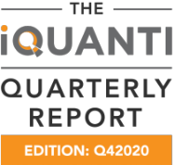
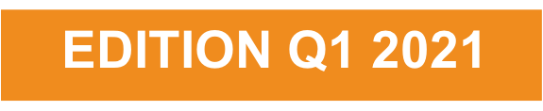
Inside the Quarterly
1. Performance Marketing Platform Updates
3. Performance Marketing Trends in Banking
2. Banking & Financial Services Industry Updates
4. iQuanti Updates

Slide 3
Performance Marketing Platform Updates

Slide 4

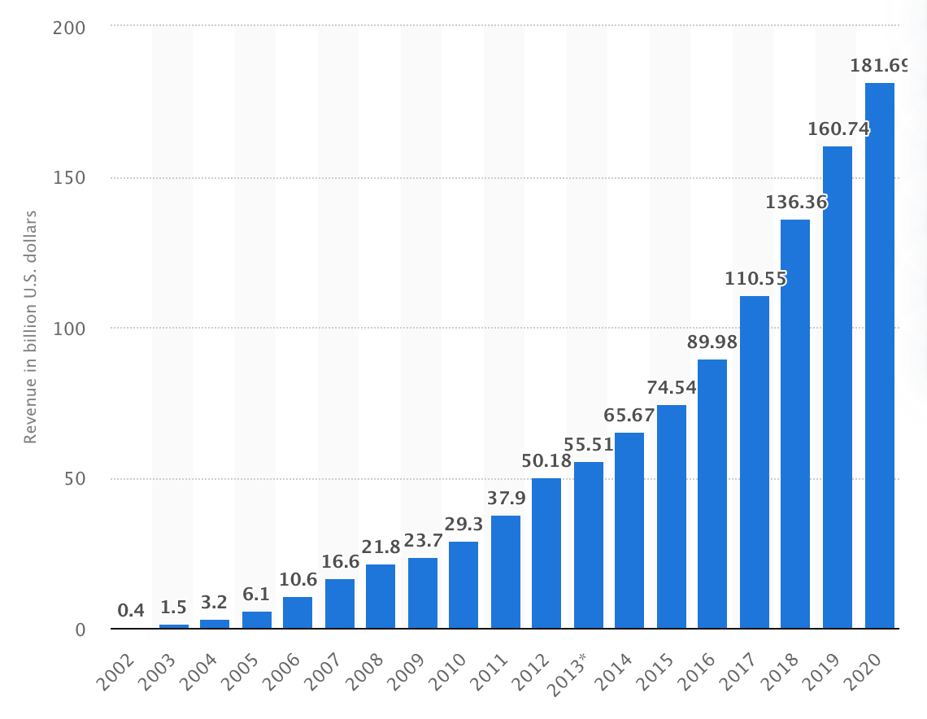
Google earnings – blockbuster quarter on continued user demand
Google reported revenue of $55.31B for Q1 2021 (34% y/y); Ad revenue ($44.6B) grew 32% y/y.
Growth driven by user demand in Google search as well as slowdown in Q1 last year (first quarter of quarantine); Q1 2020 was the slowest quarter of Google’s revenue growth.
YouTube continues to grow (49% y/y) to a little over $6B with doubling of YouTube for action users (we have been writing about this over the past year). Universal Ad Campaigns are gaining traction and will be an area to watch.
Massive increase in retail (continues) and travel (bounce-back); No other verticals were specifically spoken about.
Google pushes its e-commerce focus with new formats (organic shopping, integrated Merchant center with YT, omni-channel).
GCP (Google Cloud) gains momentum with both large firms as well as SME utilizing various cloud services.
Alphabet Revenue 2002-2020
(source: statista.com)

Slide 5
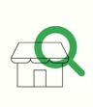
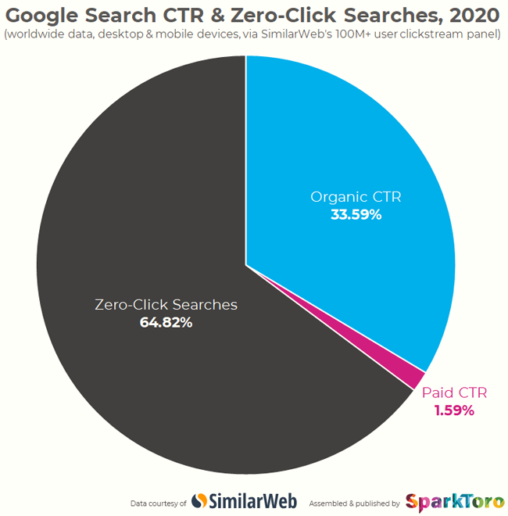


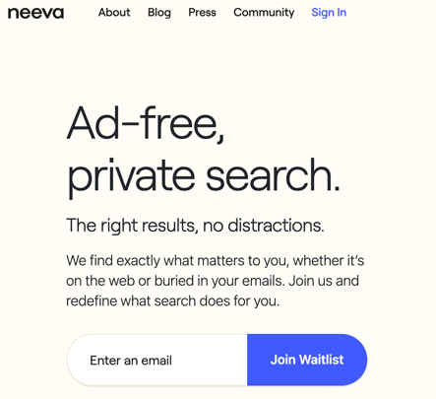
Changes and opportunities on Google
Google shares 2021 predictions: users are doing a lot more research before shopping, spending smarter and finding alternatives
Study shares: 65% of Google searches do not click on any results due to increase in app downloads, answer box results post COVID and elections and shifts in search behavior
Emergence of two new private search engines: "Neeva" by ex-Google employees and “Brave” to compete with Google in 2021
Google says: focus less on individual pages & more on category pages
BrightEdge study says: Core Web Vitals to impact and boost the Finance industry the most due to better scores already
Implications:
Create FAQ content, awareness and comparison content to help users make decisions
Implications:
Focus on long-tail keywords and FAQs, optimize mobile apps, and ensure local results and business listings are accurate
Implications:
Create content that targets all funnels of the user journey
Implications:
Ensure core web vital metrics meet the benchmarks by August 2021 to avoid rank drops
Implications:
Monitor organic search traffic by engine - even though Google owns 94% in Q1 it will start to decrease

Slide 6



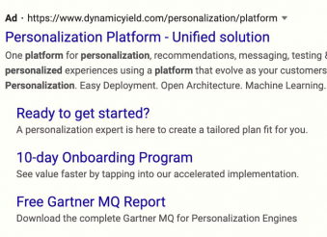

Other Paid Media Trends
In 2020, thanks to 10 years of efforts to clean up the ad space, 3.1 billion ads were blocked or removed
Microsoft suspended ~300K accounts from their advertising platform in 2020, which was a 30% increase YoY
U.S. ad spending to rise 3.2% to $237 billion in 2021 following a 5.4% drop in 2020
Google Ads test vertical sitelinks vs. horizontal, which will take a lot more search real estate
Roughly 27% of internet users are leveraging ad blockers, meaning that advertisers are missing out on roughly a quarter of potential ad targets
Implications:
Better visibility and CTRs. Focus on copy and value proposition
Implications:
Better visibility and CTRs. Focus on copy and value proposition
Implications:
Higher competition/ increase in CPCs. Focus on Quality Score and experience
Implications:
Increase in CTR to Paid Ads and decrease in CTR to Organic
Implications:
Diversify avenues of marketing beyond media

Slide 7




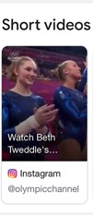




Social platforms indicate push toward digital communities and commerce
YouTube introduces Shorts, vertical video formats that allow users to create clips of 15-seconds or less, &
rises to #1 app in Consumer spend in Q1, surpassing TikTok
Twitter launches their first subscription-based product – Super Follow, which allows users to monetize their content
Snapchat leads with highest millennial audience reach and ad retention rate than any other social platform
Travel searches on Pinterest are reportedly up 60% year over year
Google SERP short videos now include Facebook, TikTok and Instagram videos apart from YouTube
ChekMarc is a new social platform, which will compete with Facebook and Linkedin
Implications:
Increase social media visibility to capture incremental traffic
Implications:
Offer exclusive content on Twitter through the brand channel
Implications:
Invest in paid social ads to capture millennial audience
Implications:
Reach travel audience through Pinterest. Start promoting travel content & products
Implications:
Monitor engagement and usage in 2021
Implications:
Invest in YouTube channel presence and create short snackable videos

Slide 8

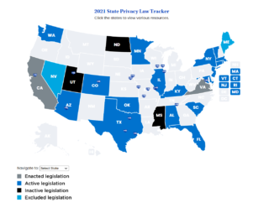
Data privacy regulations status end of Q1 – 2021
Data privacy laws have been introduced in 23 states
Passed Bills (bills have become law)
  California and Virginia
Active Bills (bills have seen some movement)
  Washington, Oklahoma, Connecticut, Florida, Illinois, New Jersey
Introduced Bills (introduced in state legislature)
  Alabama (Feb 21, 2021), Arizona (Feb 11,, 2021), Colorado (Mar 19, 2021), Kentucky (Feb 9 , 2021), Maryland (Feb 10, 2021) , Massachusetts (Feb 18, 2021), Minnesota (Jan 7, 2021), Nevada (), New York, Rhode Island (Feb 26, 2021), South Carolina (Dec 9, 2020), Texas, Vermont and West Virginia (Mar 15, 2021)
Dead Bills (bills have failed)
  North Dakota, Mississippi, and Utah
In March 2021, Virginia became the second state to enact comprehensive privacy law (Consumer Data Protection Act (CDPA)). This law will take effect January 1, 2023.
Consumer Rights:
The CDPA will provide consumers with a range of new rights including the right to opt out of the processing of personal data for sale or targeted advertising, the right to deletion, the right to amend inaccuracies, and the right to data portability.
Impact on Organizations:
This law is applicable to organizations that conduct business in Virginia or that target residents of Virginia and meet one or more for the following requirements:
  Process personal data of at least 100K consumers per calendar year
  Control and process personal data of at least 25K consumers, and the organization derives over 50% of gross revenue from the sale of personal data
Organizations will be responsible for data security and data protection assessments. They will also be responsible for vendor management obligations.

Slide 9
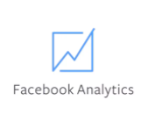
Implications of iOS 14.5 release
Facebook Analytics is Going Away
Facebook analytics will not be available after June 30, 2021. This platform is used to connect Facebook campaign data with Facebook pixel data (conversion off Facebook).
The following tools are suggested as alternatives
  Facebook Business Suite (not available to everyone): Allows users to manage their Facebook and Instagram business accounts. Offers detailed insights about a business’s audience, content, and trends.
  Ad Manager: Lets businesses view, make changes, and see results for Facebook campaigns and ads.
  Events Manager: Can help users set up and manage Facebook business tools like the Facebook pixel and Conversions API. Also reports on actions taken on a business’s website, app, and physical store.

Slide 10

Cookie Crumbling Updates
On March 3, 2021, Google announced that they will not roll out any alternatives to 3rd party cookies.
Chrome started testing of its Federated Learning of Cohorts (FLoC) proposal with a small percentage of users in the United States and across Australia, Brazil, Canada, Indonesia, Japan, New Mexico, New Zealand and Philippines.
FLoC will currently not be tested in Europe as there are concerns around it being not compliant with the privacy laws.
The latest version of the Apple’s mobile operating system, iOS 14.5, will prompt iPhone and iPad users to opt out of tracking in apps in view of creating a 'Privacy First' environment for iOS users.
Post iOS 14.5 rollout, Facebook and Instagram sends notices in iOS apps asking for consent and telling users that tracking helps keep them ‘free of charge’.

Slide 11
Banking & Financial Services Industry Updates

Slide 12

Banking Industry Updates – Broad Themes
    Continued increases in digital usage, both in activity and sales.
    Consumer deposits continue to grow year over year.
    Increases in auto loans and mortgage originations.
    Decrease in credit card and personal loan balances due to high payment rates.
    Lower interest rates also putting pressure on revenue.
    Credit provisioning continues to be lower, due to lower credit losses.
    Increases in retail spend.
    T&E spend down y/y but starting to pick up.
    Increase in marketing budgets for customer acquisition and other growth initiatives like line increases.
    Federal Reserve reports 29% of banks loosened credit standards on credit cards, with 2% tightening (27% net). Similar loosening (net 17%) for auto and other consumer loans. Mortgages may be an exception.
    Competitive activity increasing between traditional banks and digital only players.

Slide 13
JP Morgan Chase Update
Consumer deposit growth of 32% y/y, with high retention of customer balances and acquisition of new customers.
Client investment assets up 44% y/y, driven by market appreciation, and net inflow from advisor and digital channels.
Average loans down 7% y/y, driven mostly by card outstanding balances. This was offset by auto loan and lease origination volume of $11.2 billion, up 35% y/y, and mortgage loan originations that were up by 40% y/y.
Debit and credit card sale volume up 9% y/y, even with T&E spending declining.
Digital Adoption Rates:
  In Consumer banking, 50% of new checking and savings accounts were opened digitally (an increase of 10% points y/y).
  Active mobile customers up 9% y/y.

Slide 14
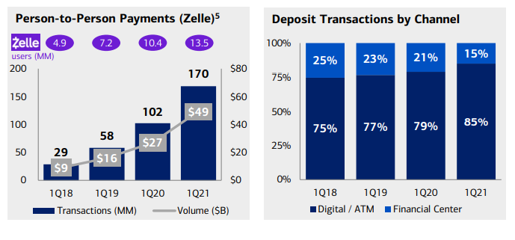
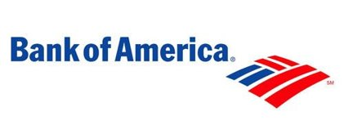
Bank of America Update
  25% y/y increase of deposits in consumer banking (61% non-interest bearing and 11% interest bearing). Drop in interest income of 16% y/y.
    Average loans and leases down by 8% y/y, driven by a 22% drop in credit card balances, but mortgages also declined by 7% y/y.
    Consumer net charge-offs declined by 8 bps y/y, but increased by 23 bps over 4Q20.
    70% of the consumer bank and 80% of wealth management households are now digitally active.
    49% of sales this year were digital.
    Credit and debit card spend increased 13% y/y, with debit increasing by 22%.
P2P payments (Zelle) continue to grow
Increasing share of deposit transactions through digital/ATM vs. branch

Slide 15
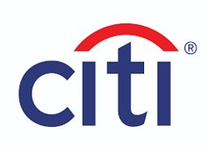
Citi Update
Overall North America consumer group revenue down 15% y/y.
  Cards: Branded cards down 11% y/y, reflecting lower average loans. Purchase sales flat y/y. Retail Services also down 26% y/y, reflecting lower loans and higher partner payments.
  Net interest: Revenues were down 12% as average loans declined by 11% on lower purchase sales activities and higher payment rates.
  Retail banking: Revenue down 8% y/y as lower deposit spreads offset strong deposit growth and momentum in wealth management.
      Average deposits: Revenues were up 22% y/y, with 30% growth in checking.
      Assets under management: 32% revenue growth y/y.
      Digital and mobile activity growth: Active digital in US – 20M, growth of 2%. Active mobile – 13M, growth of 4%.
Pursuing exit of consumer business in 13 Asia and EMEA markets, focusing on wealth management in 4 “wealth centers”: Singapore, HK, UAE, and London.
Consumer banking focus will concentrate in the US and Mexico.

Slide 16

Wells Fargo Update
    Average loans were down 9% y/y (consumer loans down 11% y/y) and average deposits were up 4% (consumer deposits up 21%). Lower charge-offs by 14 bps (23 bps in consumer loans).
    Credit card revenue was down by 2% y/y due to lower balances.
    POS volume was up 20% y/y for debit cards and 6% y/y for credit cards.
    Mortgage loan originations and auto loan originations both increased 8% y/y.
    Focus on core U.S. businesses.
      Exited the student loan business, international wealth management, and direct equipment finance in Canada.
      Entered into agreements to sell asset management and corporate trust.
    Digital (online and mobile) active customers increased 6% y/y to 32.9M.
    82% of small business and consumer deposits are made digitally, up from 76% last year, as Wells Fargo continues to close branches.

Slide 17
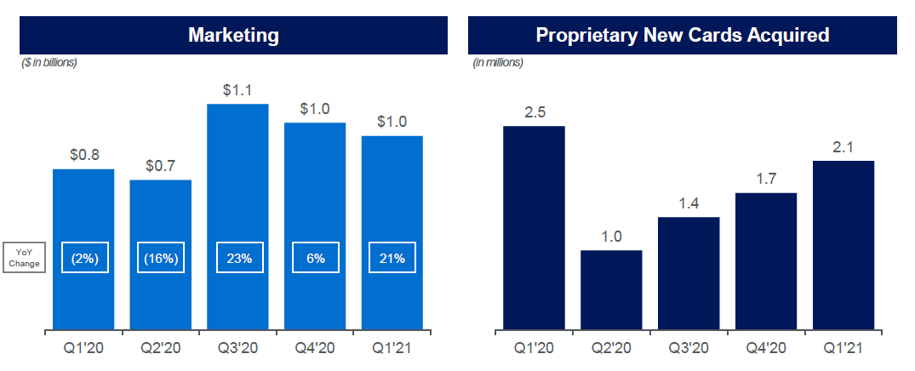

American Express Update
    American Express is focusing on 2021 as a transition year to growth in 2022.
    Q1 revenues grew for the third straight quarter, but were down 12% y/y, driven by declines in spend.
      Billed business (spend on proprietary cards) declined by 8% y/y.
      Goods & Services spend increased by 6% y/y; US Consumer spend in this category online grew 23% y/y, while offline spend declined by 9%; SME spend is 80% G&S and only declined by 3% overall.
      T&E spend declined by 50% y/y; Global Commercial T&E spend was down by 64% y/y; especially among large corporate clients, down by 79% y/y.
    Loan balances ended at $72.4B, down by 13% y/y, although new “Pay It, Plan It” feature has > $5B in AR.
    Q1 delinquencies and write-offs continue to decline to some of the lowest levels in years.
    Expanded its digital platforms including integrating the Kabbage online banking platform for SME and Resy with online ordering for restaurants.
Y/Y growth in marketing expense driving continued growth in new cards acquired

Slide 18

Capital One Update
Domestic card ending loan balances were down 19% y/y, driven by government stimulus payments and historically high payment rates.
Card spending increased 8% y/y; T&E is still lagging pre-pandemic levels but growing again.
Credit performance was strong with charge-offs declining by 214 bps y/y.
Marketing expense increased 2% y/y in Q1, but they are “leaning in” in both originations and line increases, leveraging a “modern tech stack” to deliver results.
Consumer bank ending loans increased 10% y/y, driven by auto business, which was up 16% y/y.
Q1 ending deposits in the consumer bank were up $36.4 billion or 17% y/y, from continuing elevated savings rates and government stimulus.
Competitive intensity is starting to increase as higher interchange rates are being passed along to customers in the form of rewards.

Slide 19

Marcus/Goldman Sachs Update
    Consumer banking revenues grew 32% in Q1 y/y.
    Loan balances increased to $4B in credit cards (+50% y/y) and declined to $3B in personal loans (-40% y/y). Deposits increased to > $100B.
    Goldman Sachs launched Marcus Invest platform in the U.S. for mass affluent customers. Marcus Invest will offer individuals the ability to invest as little as $1000 in GS’s proprietary asset allocation strategies. The product will also launch in UK.
    GS continues to work on the launch of a checking account product this year.
    Formally announced GM co-brand partnership to launch in September 2021.

Slide 20
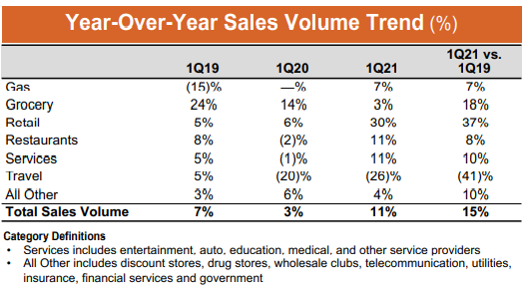
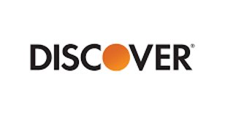
Discover Update
    Revenue was down 3%, driven by lower net interest income and a one-time gain in the prior period, offset by higher net discount and interchange revenue.
    Card receivables down 9% y/y, driven by increased payment rates (including impact of stimulus payments) and lower promo activity.
    Organic student loans up 5% y/y, driven by market share gain through the mini-peak season.
    Personal loans decreased 9% y/y, driven by increased payments and actions taken to mitigate credit risk.
    Credit loss provision decreases driven by lower net charge-offs.
    Consumer deposits grew 14% y/y.
    Increased marketing investments planned in customer acquisition and looking at line increases as well.
    Total sales volume increased 15% y/y; travel and entertainment improving significantly as economy improves.

Slide 21
Performance Marketing Trends in Banking

Slide 22
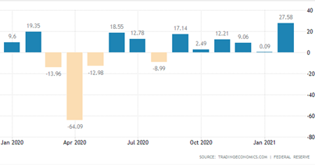
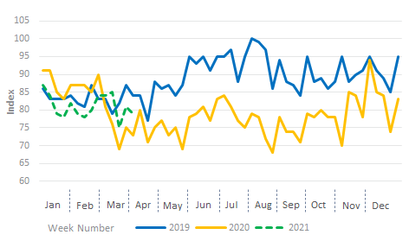
The rise in Consumer Credit has not yet triggered a rise in Credit Cards search demand
With the pandemic, there was as sharp drop in consumer spending. Alongside that, there was a corresponding decline in credit card demand. We can see a sharp uptick in consumer credit for the first time in Q1'21, but it has not yet led to a corresponding increase in searches. If the spend and need for credit continue to grow, we can expect a subsequent rise in credit card demand.
Consumer Credit (in Bn)
Google Trends
Source : Trading Economics,Google Trends

Slide 23
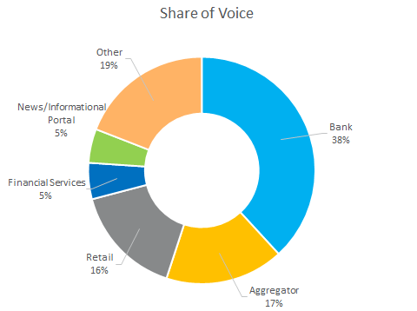
Banks lead the Credit Card Google Search Share of Voice (SOV) for Branded Keywords
Domain | SOV
Bank
citiretailservices.citibankonline.com | 7.31%
citi.com | 5.91%
chase.com | 4.28%
discover.com | 3.44%
capitalone.com | 3.41%
Aggregator
wallethub.com | 5.16%
nerdwallet.com | 3.25%
creditkarma.com | 1.61%
valuepenguin.com | 1.47%
thepointsguy.com | 1.02%
The data in this slide updated for the Mobile devices in Mar’21

Slide 24
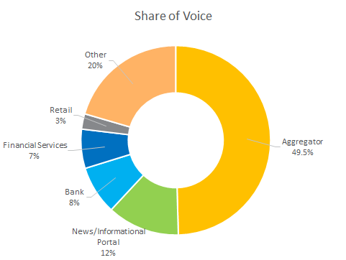
Aggregators lead the Credit Card Google Search Share of Voice (SOV) for Non-Branded Keywords
Domain | SOV
Aggregator
nerdwallet.com | 12.90%
wallethub.com | 10.17%
experian.com | 6.24%
creditkarma.com | 6.09%
bankrate.com | 2.63%
Bank
capitalone.com | 1.05%
bankofamerica.com | 1.03%
discover.com | 0.77%
chase.com | 0.63%
citi.com | 0.63%
The data in this slide updated for the Mobile devices in Mar’21

Slide 25
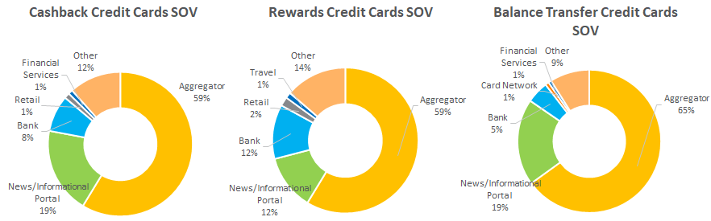
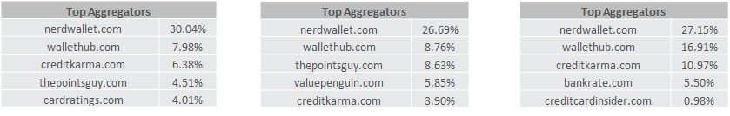
Aggregators led by NerdWallet dominate the different Credit Cards themes on Google Search
The data in this slide updated for the Mobile devices in Mar’21

Slide 26
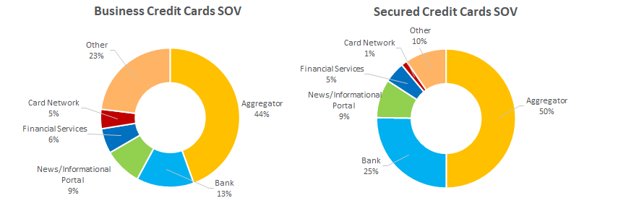
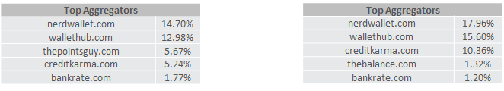
Banks share the 2nd largest part of the pie after Aggregators for Business and Secured Credit Cards
The data in this slide updated for the Mobile devices in Mar’21

Slide 27
iQuanti Updates

Slide 28
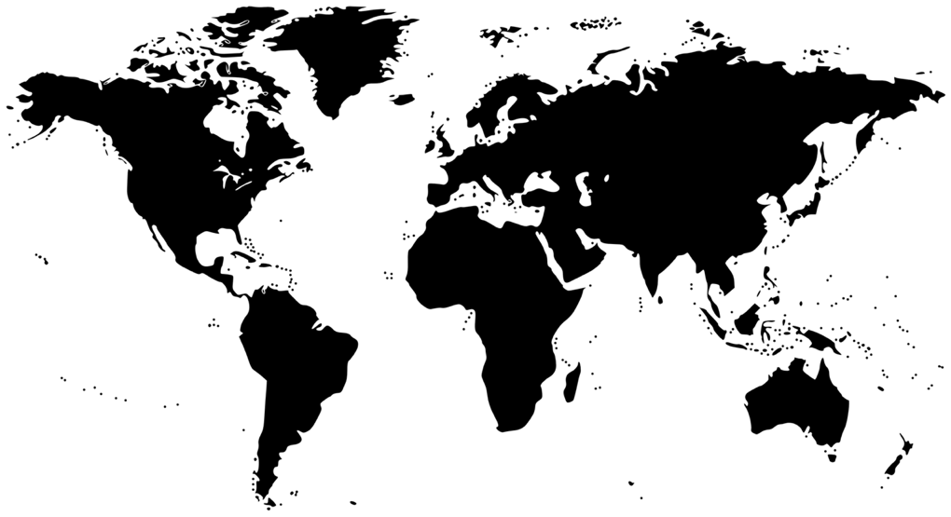


iQuanti expands its footprint with two new offices in Q1 2021
Registered iQuanti office in Toronto
Supporting US and Canada clients
Also being set up as an Analytics COE
London
Toronto
New York
San Francisco
Chicago
Mexico City
Bangalore
Singapore
New subsidiary, iQuanti Singapore Pte. Ltd., established
Supporting APAC clients

Slide 29

Recent iQuanti webinar in partnership with Search Engine Journal on SEO strategy and prioritization – available on demand
Access here:
https://www.iquanti.com/alps-enterprise-seo-tool/webinar-how-to-prioritize-seo-initiatives-for-greatest-business-impact/

Slide 30

Upcoming webinar in partnership with Forrester, on key trends in performance marketing in Banking and Financial Services
Stay tuned for the registration link from us..

Slide 31

Upcoming iQuanti webinar with Search Engine Land on improving topical authority to boost SEO ranks

Slide 32
Thank you
This document and the information in it are provided in confidence, and may not be disclosed to any third party.

